Slide 1

Chapter 1:
Introduction to Software Engineering
SOFTWARE ENGINEERING
BCC2113
TS. HAZLINA HARON
SCHOOL OF INFORMATION TECHNOLOGY

Slide 2
Frequently Asked Questions About Software Engineering (1 of 2)
Question | Answer
What is software? | Computer programs and associated documentation. Software products may be developed for a particular customer or may be developed for a general market.
What are the attributes of good software? | Good software should deliver the required functionality and performance to the user and should be maintainable, dependable and usable.
What is software engineering? | Software engineering is an engineering discipline that is concerned with all aspects of software production.

Slide 3
Frequently Asked Questions About Software Engineering (1 of 2)
Question | Answer
What are the fundamental software engineering activities? | Software specification, software development, software validation and software evolution.
What is the difference between software engineering and computer science? | Computer science focuses on theory and fundamentals; software engineering is concerned with the practicalities of developing and delivering useful software.
What is the difference between software engineering and system engineering? | System engineering is concerned with all aspects of computer-based systems development including hardware, software and process engineering. Software engineering is part of this more general process.

Slide 4
What is Software Engineering?
Engineering principles for software
Systematic and measurable approach
Involves design, development, testing, and maintenance

Slide 5
Software Engineering (2 of 2)
engineering discipline that is concerned with all aspects of software production from the early stages of system specification through to maintaining the system after it has gone into use.
Engineering discipline
appropriate theories and methods to solve problems bearing in mind organizational and financial constraints.
All aspects of software
production
Not just technical process of development. Also project management and the development of tools, methods etc. to support software production.

Slide 6
Importance of Software Engineering
- Rely on advanced software systems.
- We need to be able to produce reliable and trustworthy systems economically and quickly.
- Cheaper, in the long run, to use software engineering methods and techniques for software systems rather than just write the programs

Slide 7
Importance of Software Engineering
Manages software complexity
Enhances quality and maintainability
Enables large-scale system development

Slide 8
Software vs. Hardware
- Software: intangible, changeable
- Hardware: tangible, static
- Different lifecycle and maintenance
- Intangible and flexible
- Developed not manufactured
- Prone to frequent change

Slide 9
Types of Software
System Software
Application Software
Embedded Software
Web and Mobile Apps
AI & Data-centric Software

Slide 10
Software Development Life Cycle (SDLC)
Phases: Requirements, Design, Implementation, Testing, Deployment, Maintenance
Iterative feedback loops

Slide 11

Software Development Models
Waterfall
Agile
XP programming
SCRUM
V-Model
Spiral
Each with pros and cons

Slide 12
Requirements Engineering
Functional vs. Non-functional
Techniques: Interviews, Use Cases
Importance of clarity and testability

Slide 13

Software Design Principles
Modularity – break into smaller modules
Abstraction – show only necessary details
Encapsulation – bundle data and methods, restrict access
Separation of Concerns – organize a system – different concerns in separate places e.g data handling, business logic, UI

Slide 14
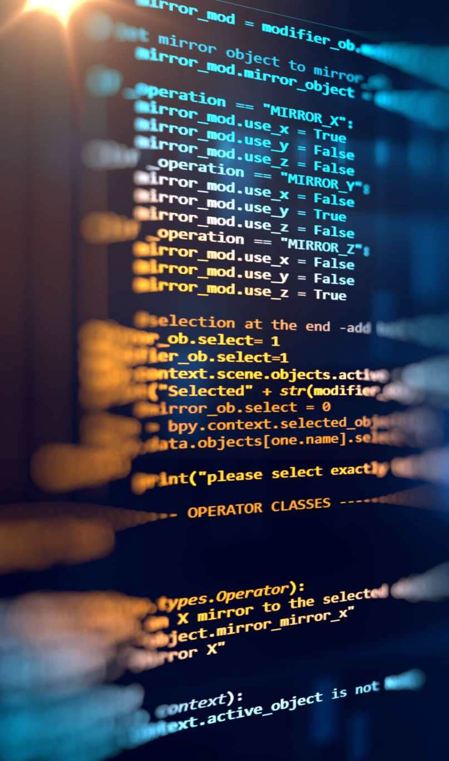
Programming and Implementation
Writing clean, efficient code
Language and tool selection
Focus on maintainability

Slide 15
Testing and Quality Assurance
Unit, Integration, System, Acceptance
Manual vs. Automated
Debugging and validation

Slide 16
Software Maintenance
-Types: Corrective, Adaptive, Perfective, Preventive
Significant part of lifecycle
Continuous improvements

Slide 17
Essential Attributes of Good Software
Product characteristic | Description
Maintainability | Software should be written in such a way so that it can evolve to meet the changing needs of customers. This is a critical attribute because software change is an inevitable requirement of a changing business environment.
Dependability and security | Software dependability includes a range of characteristics including reliability, security and safety. Dependable software should not cause physical or economic damage in the event of system failure. Malicious users should not be able to access or damage the system.
Efficiency | Software should not make wasteful use of system resources such as memory and processor cycles. Efficiency therefore includes responsiveness, processing time, memory utilisation, etc.
Acceptability | Software must be acceptable to the type of users for which it is designed. This means that it must be understandable, usable and compatible with other systems that they use.

Slide 18
Roles in a Software Engineering Team
Software Engineer
Project Manager
QA Engineer
UI/UX Designer
DevOps Engineer

Slide 19
Summary and Future Trends
Key Concepts Recap
Trends: AI, DevOps, Low-code
Lifelong learning importance

